Slide 1


Distance-vector Routing

Slide 2

Overview
Distance vector
  Assume each router knows its own address and cost to reach each of its directly connected neighbors
Bellman-Ford algorithm
  Distributed route computation using only neighbor’s info
Mitigating loops
  Split horizon and posion reverse

Slide 3

Bellman-Ford Algorithm
Define distances at each node X
  d_{x}(y) = cost of least-cost path from X to Y
Update distances based on neighbors
  d_{x}(y) = min {c(x,v) + d_{v}(y)} over all neighbors V
v
2
y
3
1
1
x
4
u
z
2
1
5
d_{u}(z) = min{c(u,v) + d_{v}(z),
c(u,w) + d_{w}(z)}
t
w ₄
3
s

Slide 4

Distance Vector Algorithm
Iterative, asynchronous: each local iteration caused by:
Local link cost change
Distance vector update message from neighbor
Distributed:
Each node notifies neighbors
only when its DV changes
Neighbors then notify their neighbors if necessary
Each node:
wait for (change in local link cost or message from neighbor)
recompute estimates
if distance to any destination has changed, notify neighbors

Slide 5

Step-by-Step
c(x,v) = cost for direct link from x to v
  Node x maintains costs of direct links c(x,v)
D_{x}(y) = estimate of least cost from x to y
  Node x maintains distance vector D_{x} = [D_{x}(y): y є N ]
Node x maintains its neighborsʼ distance vectors
  For each neighbor v, x maintains D_{v} = [D_{v}(y): y є N ]
Each node v periodically sends D_{v} to its neighbors
  And neighbors update their own distance vectors
  D_{x}(y) ← min_{v}{c(x,v) + D_{v}(y)} for each node y ∊ N

Slide 6

Example: Initial State
Info at node | A | Distance B C |  | to | Node D E
A B C D E | 0 7 ∞ ∞ 1 | 7 0 1 ∞ 8 | ∞ 1 0 2 ∞ | ∞ ∞ 2 0 2 |  | 1 8 ∞ 2 0
B
1
C
7
A
8
2
1
E
2
D

Slide 7

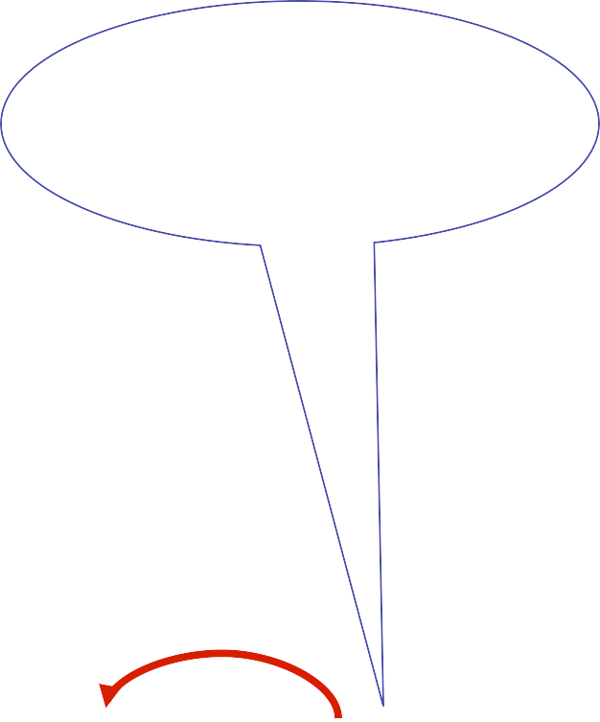
D sends vector to E
Iʼm 2 from C, 0 from D and 2 from E
Info at node | A | Distance B C |  | to | Node D E
A B C D E | 0 7 ∞ ∞ 1 | 7 0 1 ∞ 8 | ∞ 1 0 2 4 | ∞ ∞ 2 0 2 |  | 1 8 ∞ 2 0
B
1
C
7
A
8
2
1
E
2
D
D is 2 away, 2+2< ∞, so best path to C is 4

Slide 8


B sends vector to A
Iʼm 7 from A, 0 from B, 1 from C & 8 from E
Info at node | A | Distance B C |  | to | Node D E
A B C D E | 0 7 ∞ ∞ 1 | 7 0 1 ∞ 8 | 8 1 0 2 4 | ∞ ∞ 2 0 2 |  | 1 8 ∞ 2 0
B
1
C
7
A
8
2
1
E
2
D
B is 7 away, 1+7< ∞ so best path to C is 8

Slide 9

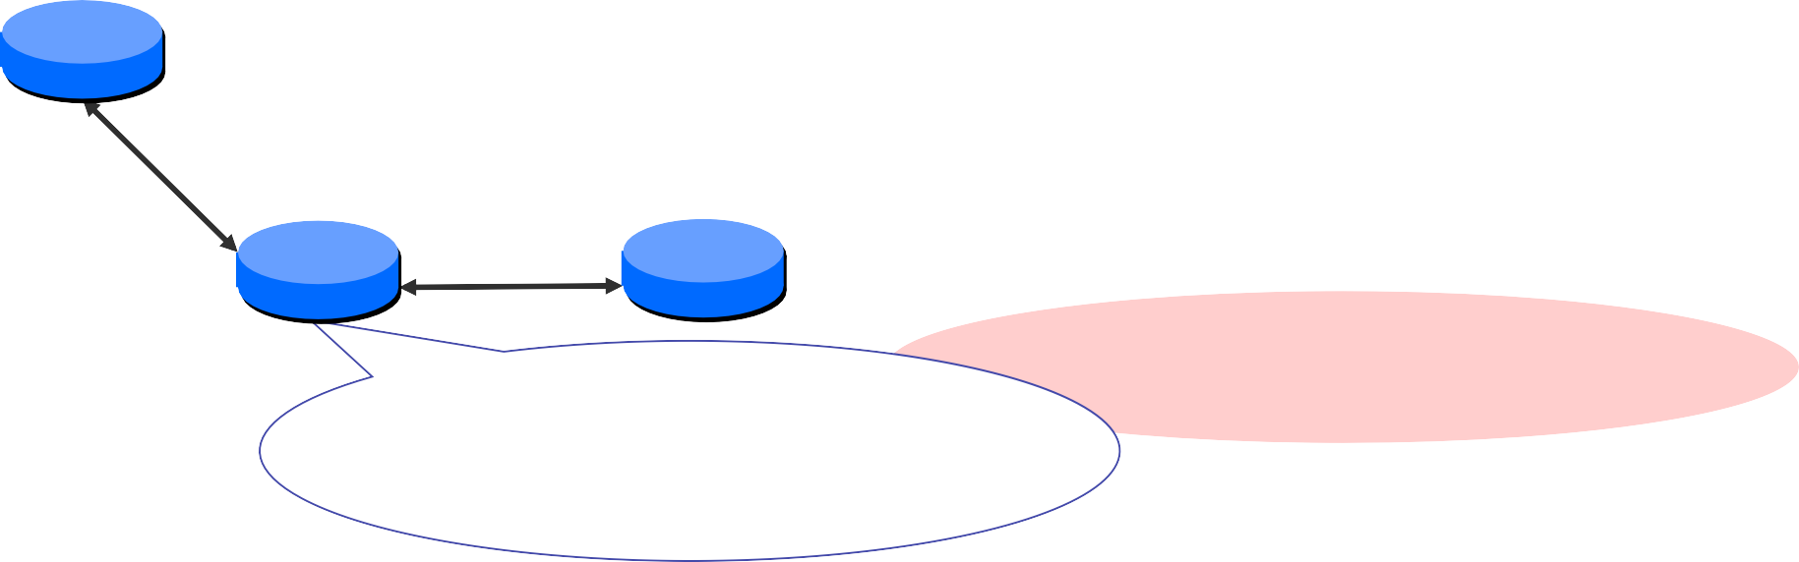

E sends vector to A
E is 1 away, 4+1<8
so C is 5 away, 1+2<
∞ so D is 3 away
Info at node | A | Distance B C |  | to | Node D E
A B C D E | 0 7 ∞ ∞ 1 | 7 0 1 ∞ 8 | 5 1 0 2 4 | 3 ∞ 2 0 2 |  | 1 8 ∞ 2 0
B
1
C
7
A
8
2
1
E
2
D
Iʼm 1 from A, 8 from B, 4 from C, 2 from D & 0 from E

Slide 10

…until Convergence
Info at node | A | Distance B C |  | to | Node D E
A B C D E | 0 6 5 3 1 | 6 0 1 3 5 | 5 1 0 2 4 | 3 3 2 0 2 |  | 1 5 4 2 0
B
1
C
7
A
8
2
1
E
2
D

Slide 11

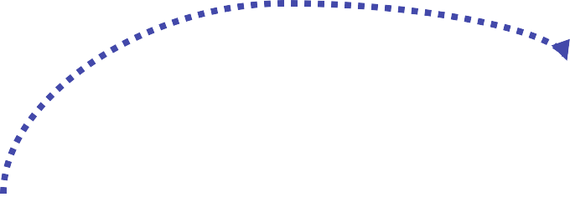
Node Bʼs distance vectors
Dest | Next hop A E C
A C D E | 7 9 6 12 12 1 10 10 3 8 8 5
B
1
C
7
A
8
2
1
E
2
D

Slide 12

Handling Link Failure
A marks distance to E as ∞ , and tells B
E marks distance to A as ∞ , and tells B and D
B and D recompute routes and tell C, E and E
etc… until converge
Info at node | A | Distance B C |  | to | Node D | E
A B C D E | 0 7 8 10 12 | 7 0 1 3 5 | 8 1 0 2 4 | 10 3 2 0 2 |  | 12 5 4 2 0
B
1
C
7
A
8
2
1
E
2
D

Slide 13

Counting to Infinity
Distance to C
3
A
2
B
1
2
C
3
A
4
B
1
C
Update 3
5
A
4
B
1
C
Etc…
Update 4

Slide 14

Why so High?
Updates donʼt contain enough information
Canʼt totally order bad news above good news
B accepts Aʼs path to C that is implicitly through B!
Aside: this also causes delays in convergence even when it doesnʼt count to infinity

Slide 15

Mitigation Strategies
Hold downs
  As metric increases, delay propagating information
  Limitation: Delays convergence
Loop avoidance
  Full path information in route advertisement
  Explicit queries for loops (e.g. DUAL)
Split horizon
  Never advertise a destination through its next hop
» A doesnʼt advertise C to B
  Poison reverse: Send negative information when advertising a destination through its next hop
» A advertises C to B with a metric of ∞
» Limitation: Only works for “loop”s of size 2

Slide 16

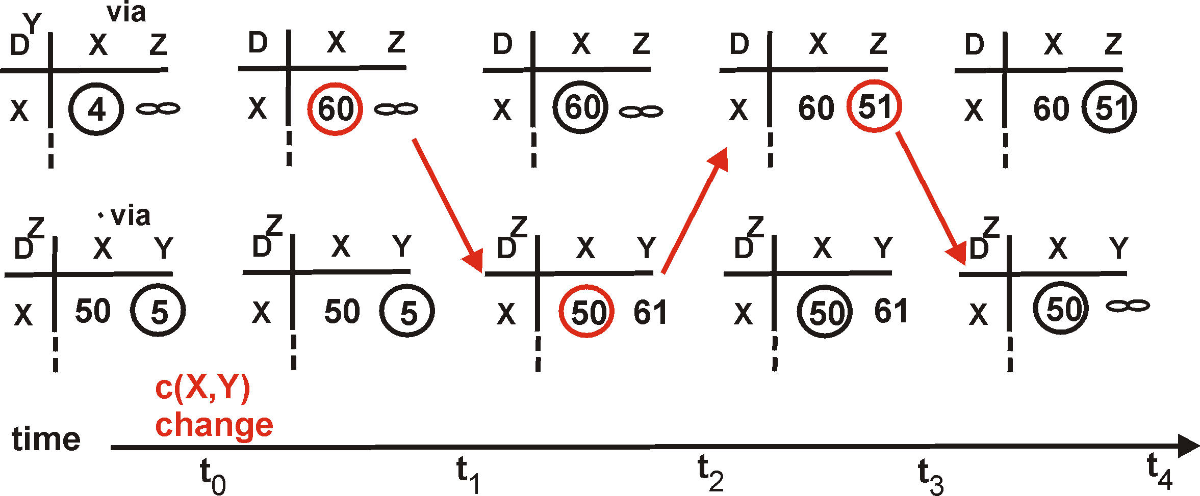
Poison Reverse Example
If Z routes through Y to get to X:
Z tells Y its (Zʼs) distance to X is infinite (so Y wonʼt route to X via Z)
60
4
Y
1
X
Z
50

Slide 17

Split Horizon Limitations
B
● A tells B & C that D is unreachable
1
1
● B computes new route through C
Tells C that D is unreachable (poison reverse)
Tells A it has path of cost 3 (split horizon doesn’t apply)
A
C
1
1
A computes new route through B
  A tells C that D is now reachable
D
● Etc…

Slide 18

Routing Information Protocol
DV protocol with hop count as metric
  Infinity value is 16 hops; limits network size
  Includes split horizon with poison reverse
Routers send vectors every 30 seconds
  With triggered updates for link failures
  Time-out in 180 seconds to detect failures
RIPv1 specified in RFC1058
  www.ietf.org/rfc/rfc1058.txt
RIPv2 (adds authentication etc.) in RFC1388
  www.ietf.org/rfc/rfc1388.txt

Slide 19
Link-state vs. Distance-vector
Message complexity
LS: with n nodes, E links, O(nE) messages sent
DV: exchange between neighbors only
Speed of Convergence
LS: relatively fast
DV: convergence time varies
  May be routing loops
  Count-to-infinity problem
Robustness: what happens if router malfunctions?
LS:
Node can advertise incorrect
link cost
Each node computes only its
own table
Node can advertise incorrect
path cost
Each nodeʼs table used by others (error propagates)
DV:

